Slide 1
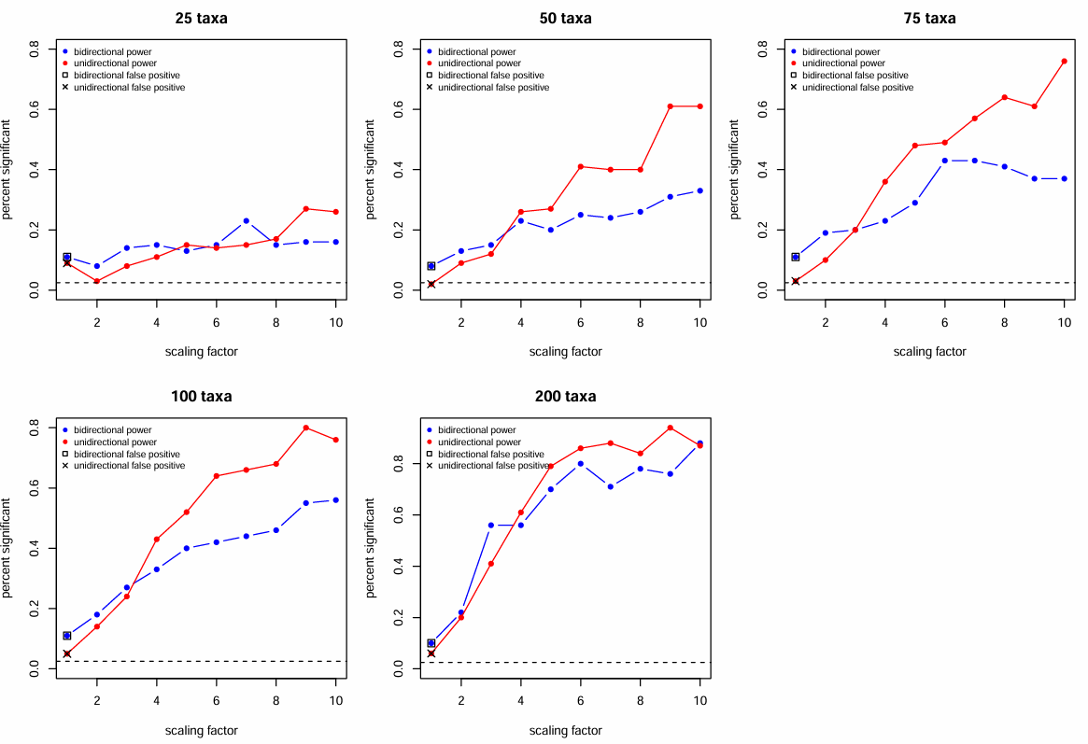

Slide 2
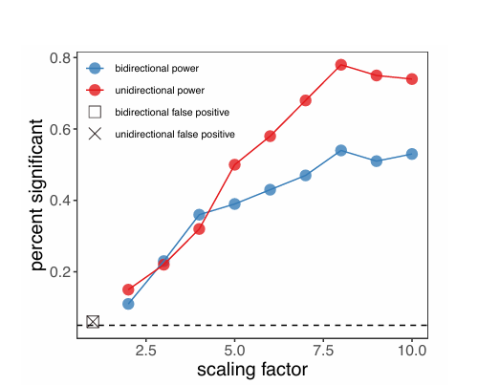
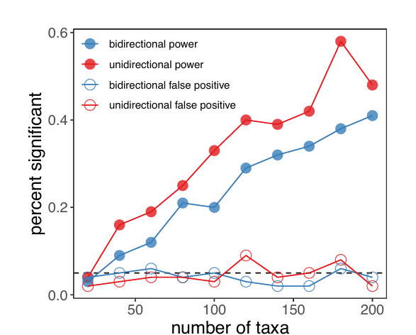
Taxa: 200
Sf: 1-10 (10)
(Description says blue line is uni (scenario 1), and red is bi (scenario 2))
Taxa: 20:200 (10)
Sf : 1 & 5
(Description explicitly calls the red line bidirectional and blue as uni)

